Slide 1

SuperMart Grocery Sales-Retail Analysis
SUBMITTED BY :
NAME: Nishant Aher & Akshat PArdeshi

Slide 2

Introduction
The dataset given has data on orders placed by customers on supermart grocery store in the different cities of the state Tamil Nadu in the time period of 4 years.
In the given dataset the Order Count is 9994, with the Total Sales of ₹1,49,56,982 & Total Profit of ₹37,47,121.

Slide 3
Objectives Of Analysis
The objectives of the project is to:
Perform exploratory data analysis to discover any insights and patterns.
Find out if there are any products that are performing above/below or above average.
The main parts of this project consists of:
Data pre-processing steps.
Exploratory data analysis.

Slide 4
Observations From The Data
Total orders = 9994
Total regions = 5
Total cities = 24
Total categories = 7
Total sub-categories = 23
Total customers = 50
Total state = 1
Total years = 4

Slide 5
Problem Statements
Which category of product is best performing?
Which city was the highest number of snacks sold?
What are the top Sub Categories according to profit?
Which city was the highest number of Health Drinks sold?
Which are top 5 cities with the maximum sales and the minimum sales?
Top 5 customers by sales?
Which region have the highest number of orders in the categories?
Which region have the highest sales and profit ?
Which month does the business have the highest sales?
Which year have the most sales and profit?

Slide 6
Insights
Snacks is the most profitable category and also the best performing category in terms of sales.
The top 5 Cities with highest sales of Snacks are Kanyakumari, Virudhnagar, Tirunelveli, Perambalur and Chennai.
In the City of Kanyakumari highest number of snacks are sold.
The most profitable sub category is Health Drinks, with Soft Drinks following it to be the 2nd highest.
Rice and Chicken are the least profitable Sub-Category.
In Ramanadhapuram highest number of Health Drinks have been sold.
Kanyakumari, Vellore, Bodi, Tirunelveli & Perambalur are the Cities with the Maximum Sales.

Slide 7
Trichy, Nagercoil, Dharmapuri, Dinigul & Theni are the Cities with Minimum Sales.
Krithika, Amrish, Verma, Arutra and Vidya are the Top 5 Customers with respect to sales.
The Western region is the best performing region as it has the highest number of products sold for all the categories.
The Western Region (31.8%) has the Highest Sales and Profit followed by the Eastern Region (28.7%) with the Southern region (16.6%) having the Lowest Sales and Profit over the period of 4 years.
In the month of November the highest sales are recorded.
And in February the sales are the lowest.
The highest sales and profit where in the year 2018.
The lowest sales and profit where in the year 2015.

Slide 8
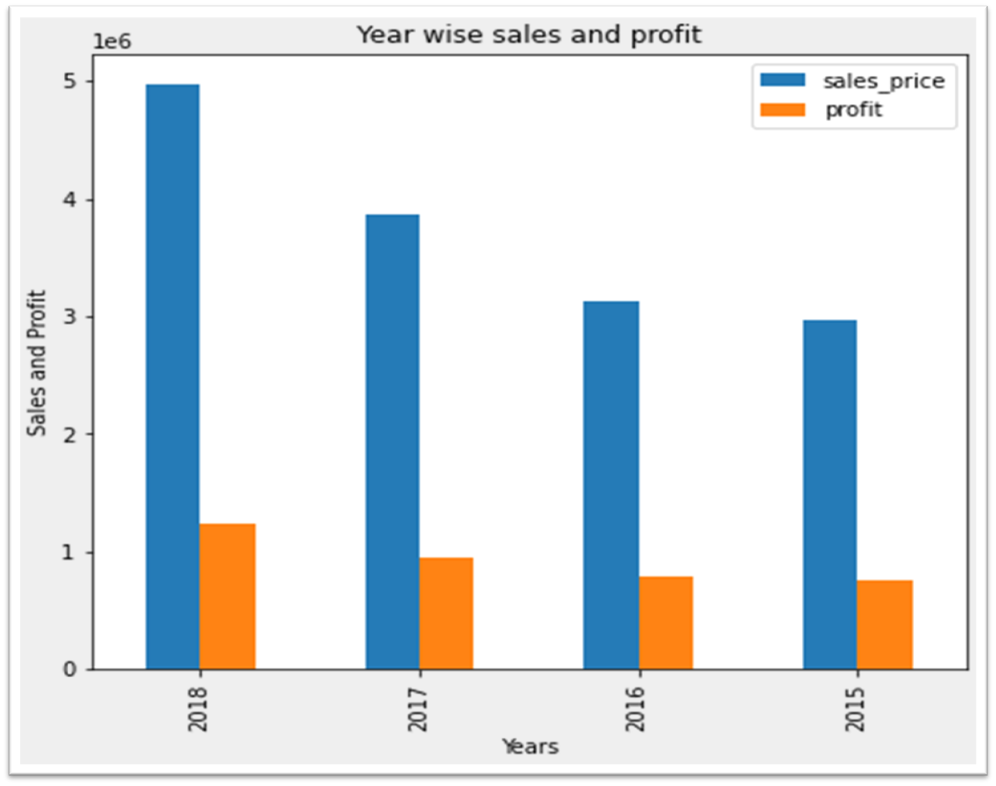
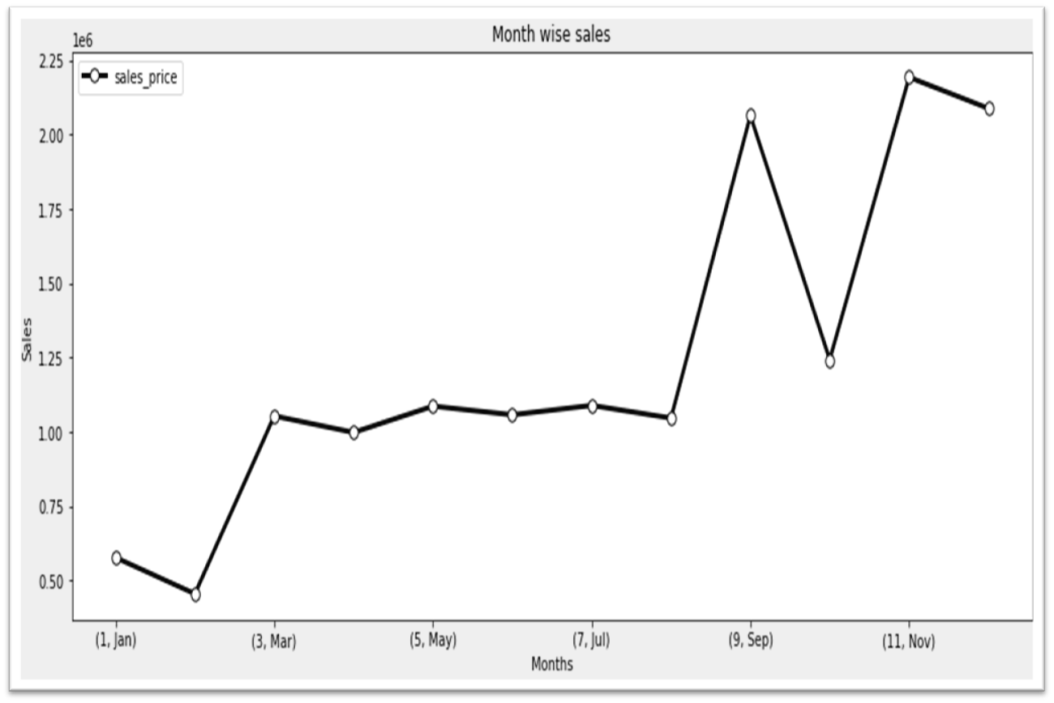
Visualization

Slide 9
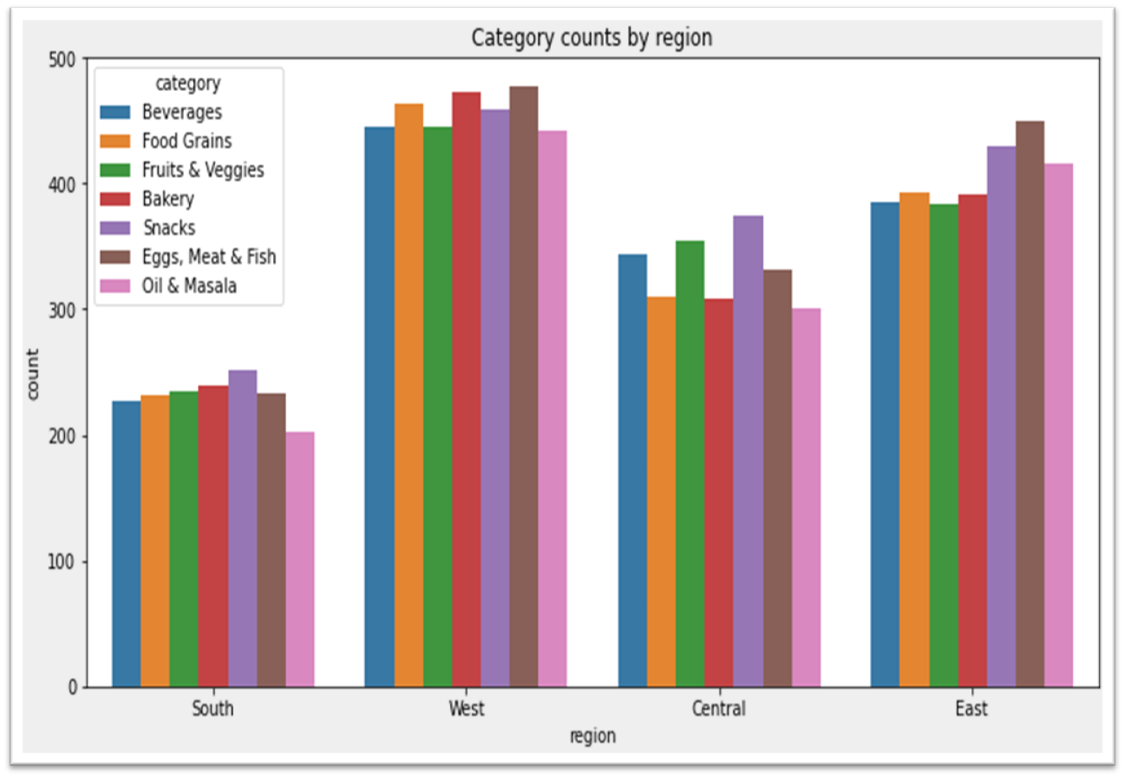
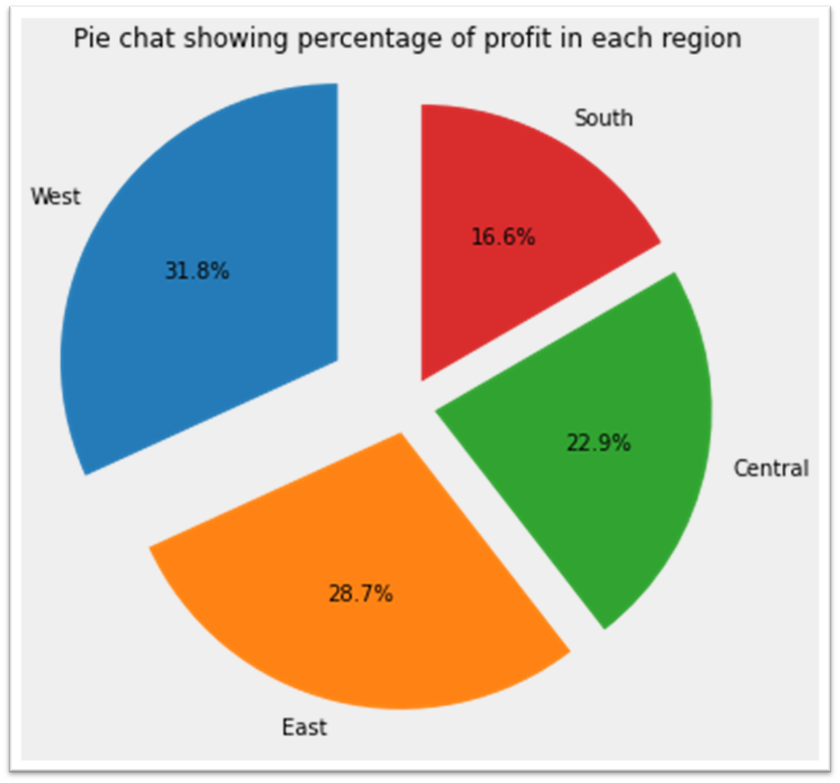

Slide 10
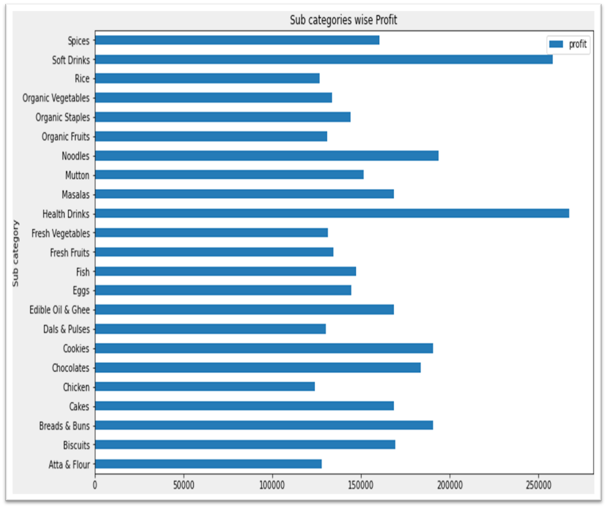

Slide 11
SUMMARY
The Supermart is a growing and profitable business as the profit increases yearly from 2015 to 2018.
The Western region is the best region where sales and profit are the highest.
With the city of Kanyakumari having highest sales while Trichy having lowest sales
Health Drinks and Soft Drinks are the most profitable Products while Chicken and Rice are the least profitable Products.
Snacks is the most profitable category and Oil & Masala are the least performing category.
There is always an increase in sale in the month of September, November and December with November being the month with the highest sales.

Slide 12


